Slide 1

Authoritative Data Environment (ADE) Reference Implementation (RI)
Demonstration and Status Update
22 January 2019

Slide 2

Enable tomorrow’s navy today through a cloud-native reference implementation to meet transformation and analytic Demands
Unclassified Draft//Pre-Decisional

Slide 3


Challenges of ADE 2.0
Outdated Technology
Manual Intervention
Lift and shift of current relational data warehouses to cloud with no modernization
Cannot discover information in file-based data like PDF, MS Word, etc.
Depends on traditional hand-maintained servers
Analytics remains highly manual
Significant customization of servers and applications
Confusing, complex scalability controls limits cloud effectiveness
Inflexible to changing Navy requirements
Unclassified Draft//Pre-Decisional

Slide 4


Case Studies Showing Importance of Cloud-Native Tech
UK Data Service
Duolingo
Facilitates broad access to data while protecting sensitive data
“… not a good use of resources for us to replicate the millions of dollars in investments that [cloud] vendors are making”
Data lake hosted in Amazon S3, using Apache HBase and Apache Spark to drive data search/viz.
Online language training site, 18 million users monthly.
“Our company relies heavily on Amazon DynamoDB not just for its highly scalable database, but also for high performance”
“We plan on utilizing AWS Lambda for microservices architecture”
Unclassified Draft//Pre-Decisional

Slide 5










Architectural Overview - Reference Implementation
CB - Please remove and move to backup. Non-Techies will never understand this slide.
APIs
Security
AWS API Gateway
AWS Lambda
ANALYTICS
AWS Comprehend
AWS Athena
METADATA MANAGEMENT
AWS Glue
Full Platform as a Service (PaaS) Architecture
SEARCH
AWS ElasticSearch
DATA STORAGE
AWS S3
AWS DynamoDB
SEARCH
AWS ElasticSearch
DATA INTEGRATION
Apache NiFi
AWS Lambda
INFRASTRUCTURE MANAGEMENT
Unclassified Draft//Pre-Decisional

Slide 6
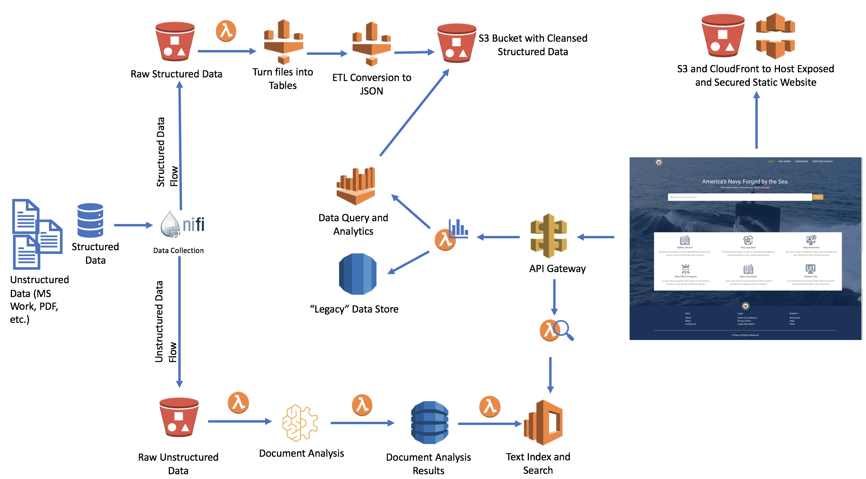
Technical architecture
CB - Please remove and move to backup. Non-Techies will never understand this slide.
Cloud Native Architecture
Mobile first web design
Cloud Scale storage
Analytics as a Service
Unclassified Draft//Pre-Decisional

Slide 7

Cloud Services for ADE RI
Service | Description | Available to public | Available Federally | Available to DoD
AWS Lambda | Run simple code with no servers | 2014
AWS Athena | Run familiar database queries on modern cloud storage and databases at massive scale | 2016
AWS S3 | Low cost cloud storage | 2006
AWS DynamoDB | Fully managed, highly available database that delivers fast performance at any scale | 2012
AWS Comprehend | Natural Language Processing (NLP) analytic engine | 2017
AWS Glue | Fully managed data import and load (ETL) service that moves data to the cloud | 2017
ElasticSearch | Google-like search on MS Word, PDF, Text and other unstructured data | 2015
AWS API Gateway | Create, publish, maintain, monitor, and secure APIs at any scale | 2015
AWS RDS | Traditional relational database to emulate legacy data store | 2009
AWS ECR | Registry of “containerized” executable applications | 2015
AWS ECS | Provision, configure, and scale clusters of applications | 2015
AWS Fargate | Provision, configure, and scale clusters of applications on demand | 2017
Unclassified Draft//Pre-decisional
Notes:
FedRAMP can now accredit new services in 6 months or less, and typical turnaround times are 4-5 months. See https://www.fedramp.gov/assets/resources/documents/FedRAMP_Accelerated_A_Case_Study_For_Change_Within_Government.pdf

Slide 8
Demonstration

Slide 9


ADE 2.0 versus ADE RI
ADE 2.0
ADE RI
Compliant & traditional
Modern & advanced
Focus on O&M
Scale Up/Down with Human Intervention
Analysis only with Pre-screened “structured” Data
Hunting and Pecking for data
Siloed, non-collaborative analytics
Focus on Innovation
Fully Automated Scale Up/Down
Greater Insights with All Available Pertinent Data
Google-like Search
Real-time data analytics
Unclassified Draft//Pre-Decisional

Slide 10
ADE Reference Implementation Data Improvements
Search and find documents in PDF, MS Word and other text based formats
Schema flexibility in “NoSQL” architecture allows productive data integration
Begin 55-1 before all data elements are fully standardized
There are 40,000+ data elements within the N1 portfolio!
Allows changes to data format based on the needs of MPT&E
Software and Platform as a Service provides inherent capabilities to reduce possibility of an outage
Proven experimentally by use of a large Google-sponsored publicly available data set, GDelt.
This data set is 250 gigabytes, and was fully ingested and searchable.
Unclassified Draft//Pre-Decisional

Slide 11






Why It Matters
Flexible Enough for Transformation and 55-1
Provides flexibility to adjust to data changes and volume
Future Proof
Cloud first architecture reduces maintenance of software and allows the Navy to quickly use new capabilities
Significantly Lower Costs
Automatically adjusts to user demand, lowering computing consumption costs
Focus on Innovation
Reduced time and money for “keeping the lights on” is push to solving business needs
Built to Support Manning the Fleet
Building proof of concept of future FMRD system
Requires Senior Leadership Assistance
Clear policy barriers that enforce legacy approaches
Unclassified Draft//Pre-Decisional

Slide 12
Backup

Slide 13
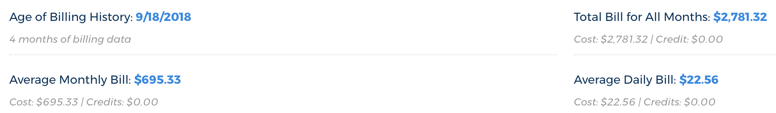
Labor and cloud Costs
Cloud Costs as of 1/22/2019
Labor Information as of 12/31/2018
Environment Ready: 9/25
3 FTE ADE
3 Cyber FTE
Add Designer (1 FTE)
Add ElasticSearch Developer (1 FTE)
Hours Worked – 2,403.75
Labor Costs - $337,337.06
13 Staff – Not all Full Time
September
October
November
December
January
Environment Requested: 9/18
Add Front End Developers (3 FTE)
Add .5 FTE Cloud Architect

Slide 14
ADE 2.0 Costs
RDTE:
FY18: approx. $9M
FY19: Budgeted $10.5M
OMN:
FY18: approx. $9M
FY19: Budgeted $11M

Slide 15
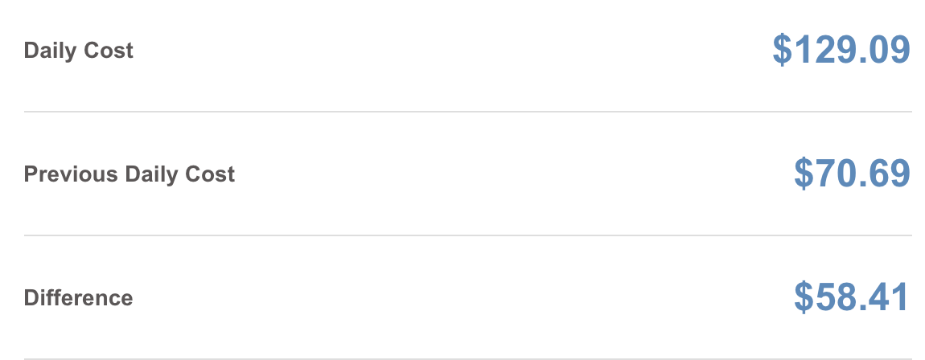
Daily costs as of 17 Jan 2019
CB: Suggest removing in favor of earlier slide
Increase in costs is due to the ingest of GDELT Event data
Unclassified Draft//Precision

Slide 16
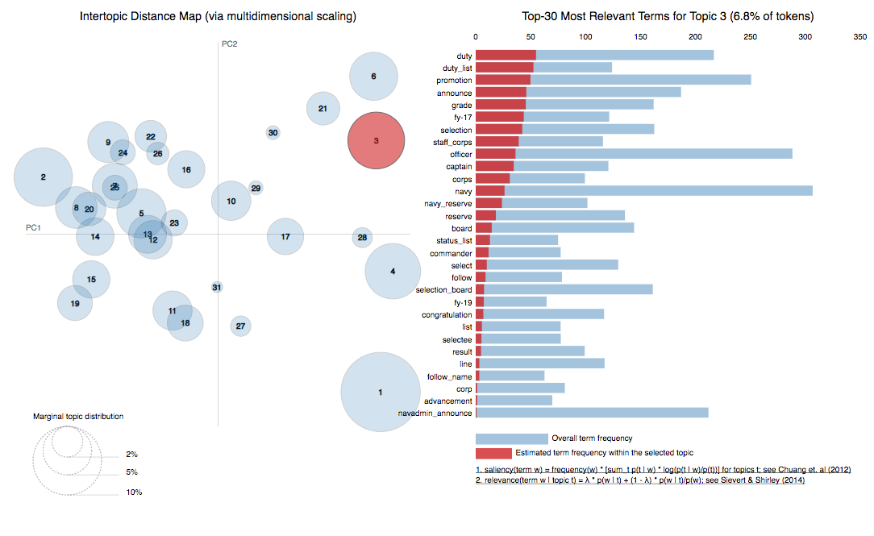
Topic cluster data dump
Technology used: Python’s NLP libraries: Gensim, Spacy
NLP algorithms: TF-IDF, LDA
Unclassified Draft//Precision

Slide 17














API as a “Switchboard’
Spaghetti Code
Clean Abstraction
EXTERNAL API LAYER
INTERNAL API LAYER

